Slide 1

SQL(i)
Presented by:
Abdullah Tarar
Ali Oun
Saad Ali
Saad Hanif

Slide 2

Introduction
SQL injection (SQLi) is a web security vulnerability that allows an attacker to interfere with the queries that an application makes to its database. This can allow an attacker to view data that they are not normally able to retrieve. This might include data that belongs to other users, or any other data that the application can access. In many cases, an attacker can modify or delete this data, causing persistent changes to the application's content or behavior.

Slide 3

HOW IT ARRIVES
SQL Injection vulnerabilities arise due to inadequate input validation and poor coding practices in web applications.
Web applications often take user input, such as form data, as part of their functionality. If this input is not properly validated or sanitized, it can be manipulated by attackers
Error messages generated by the database system, if not handled properly, can reveal information about the structure of the database. Attackers may use this information to refine their injection attacks.

Slide 4

Exploitation sql Injection
Methodology: Attackers inject malicious SQL code to manipulate database queries.
Goal: Bypass authentication, extract sensitive information, or modify/delete data.

Slide 5
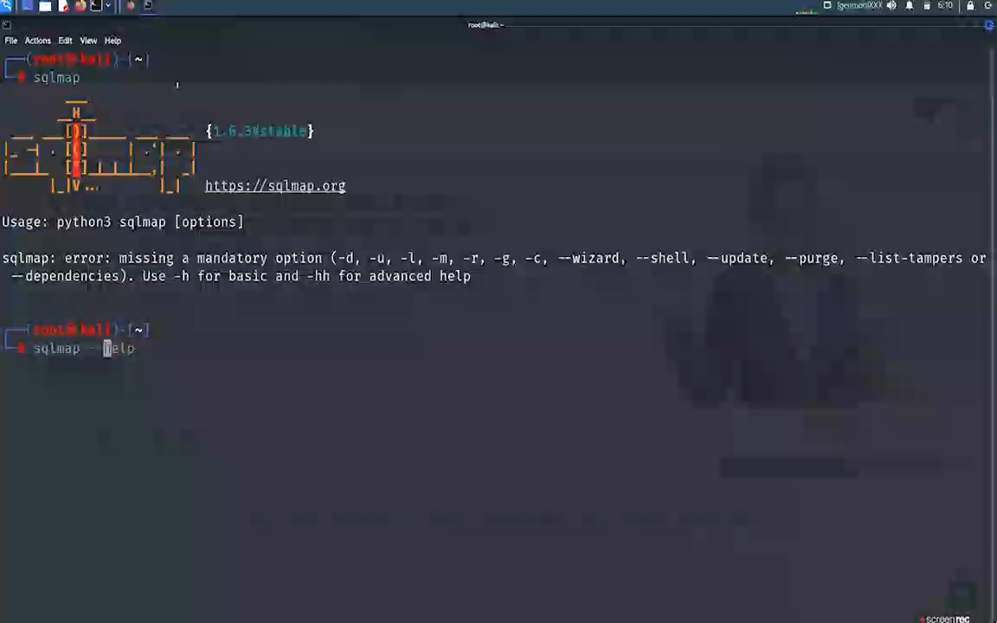
Exploitation techniques
Union-based SQLi:.
Combining results from two different queries.
Error-based SQLi:
Exploiting error messages to gather information.
Time-based Blind SQLi:
Delaying the response to infer the truth.

Slide 6

HOW TO PATCH
Input Validation: Validate and sanitize user inputs before incorporating them into SQL queries.
Parameterized Statements: Use parameterized queries to separate SQL code from user input.
Least Privilege Principle: Limit database user privileges to minimize potential damage.
Web Application Firewalls (WAF): Implement WAFs to detect and block SQL Injection attempts.

Slide 7
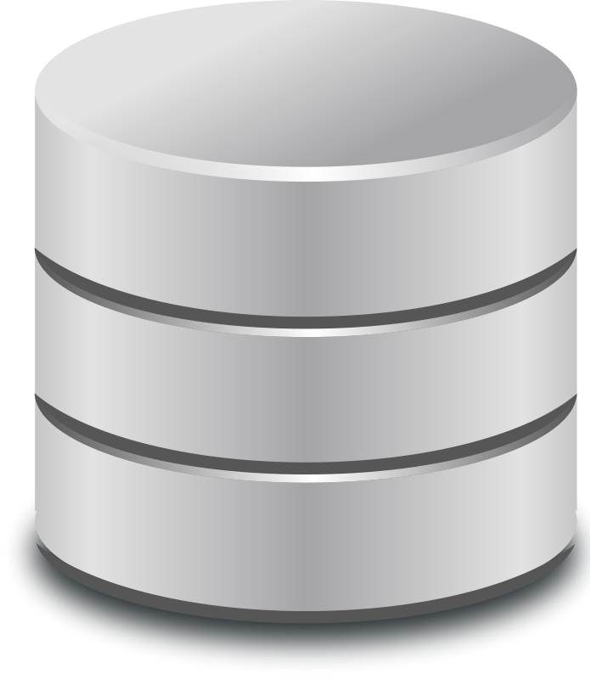
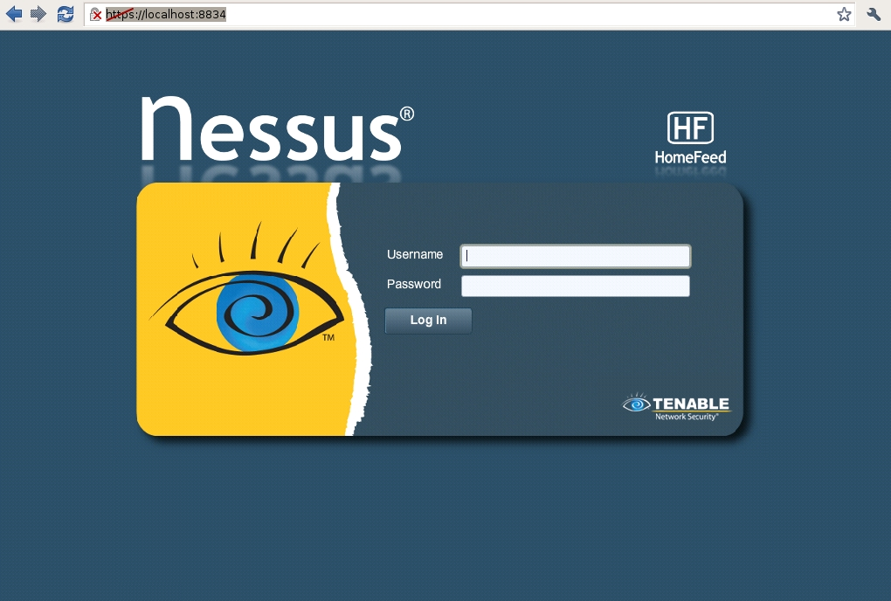
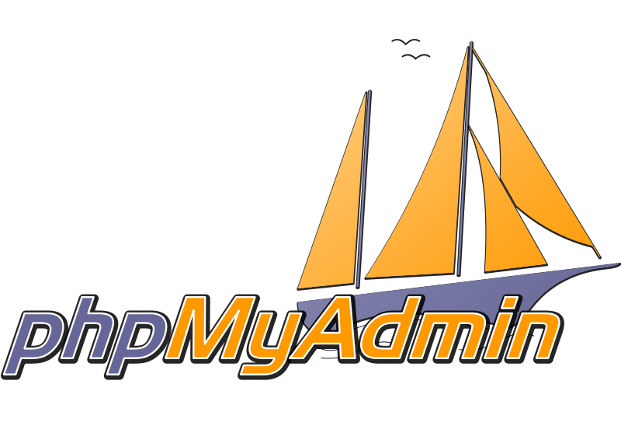
Tools used in sql injection
sqlmap
nussus
phpmyadmin

Slide 8
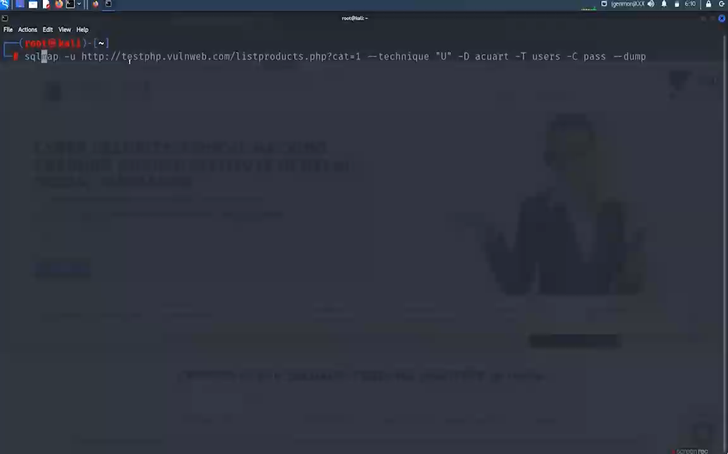
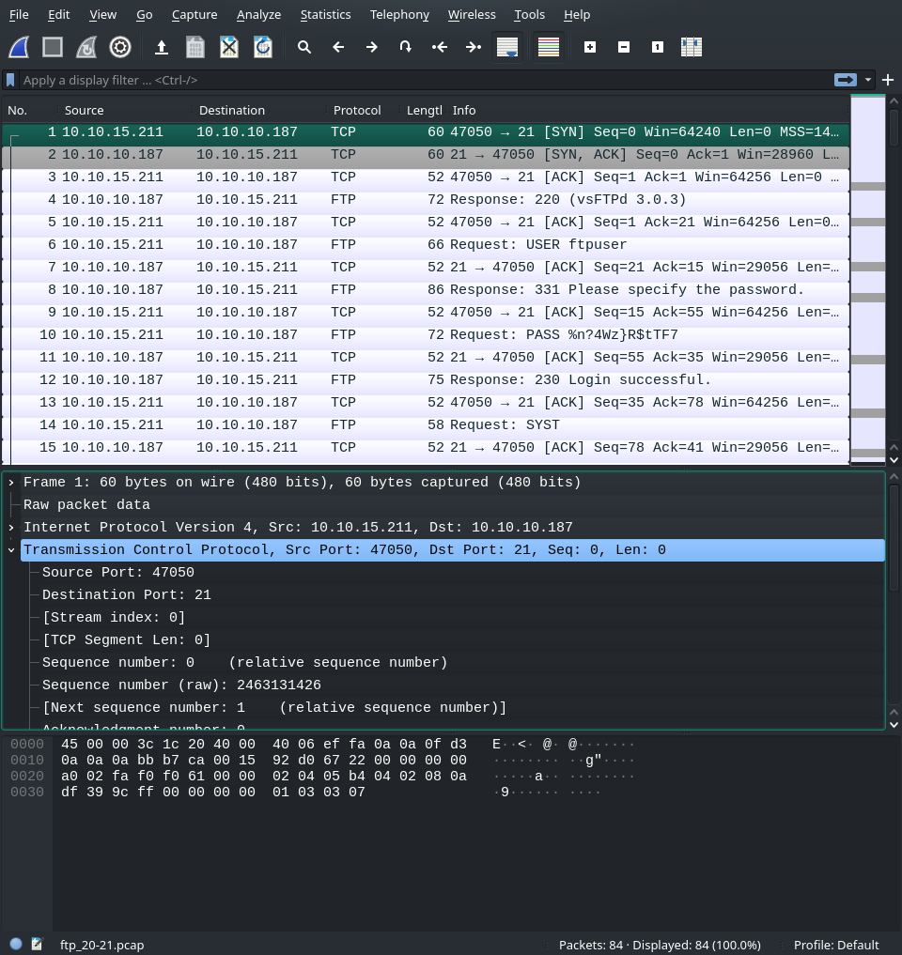
sqlmap
URL Targeting: Specify the target URL of the vulnerable web application.
Detection: SQLMap analyzes the target and automatically detects potential SQL injection points.
Exploitation: Exploit the detected vulnerabilities to extract information from the database.
Enumeration: Enumerate and extract data from databases, tables, and columns.
Post-Exploitation: Execute additional commands to extend the exploitation process.

Slide 9
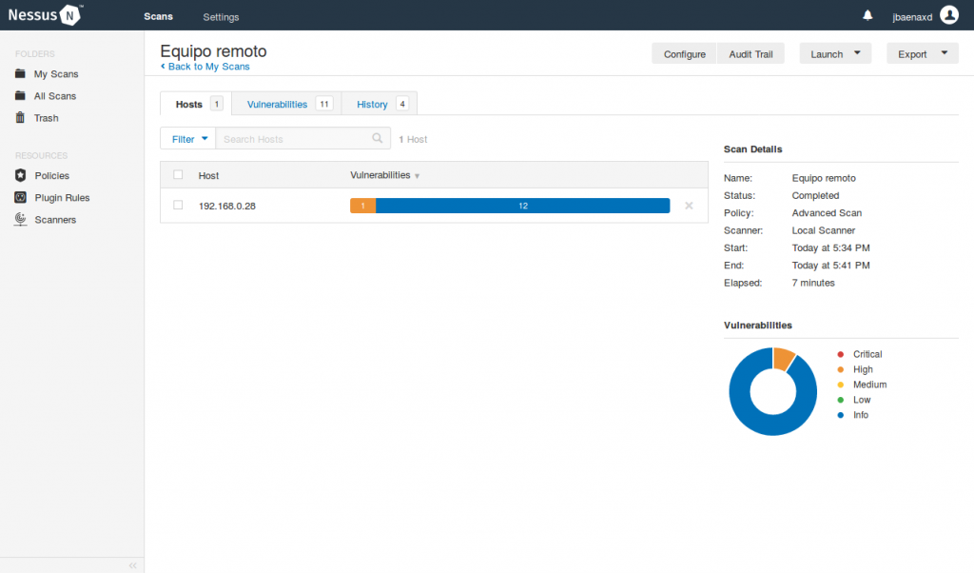
nessus
Target Specification: Define the scope by specifying target IP addresses, domains, or networks.
Scanning: Nessus conducts vulnerability scans using a variety of plugins and techniques.
Vulnerability Detection: Identify and categorize vulnerabilities based on severity levels.
Policy Compliance Checks: Assess systems against predefined policies and regulatory standards.
Reporting: Generate detailed reports with actionable insights and recommendations for remediation.

Slide 10

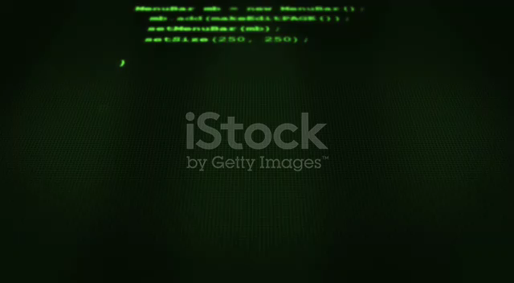
Conclusion
In conclusion, SQL Injection is a prevalent and dangerous vulnerability. Understanding the risks, exploitation techniques, and preventive measures is crucial. Regularly update and patch systems to protect against evolving threats.

